Slide 1
Airbnb - EDA Project
Exploratory Data Analysis | Visual Insights | Python & Pandas

Slide 2
Project Overview
Performed an Exploratory Data Analysis on Airbnb NYC 2019 dataset.
- Focused on trends in room types, pricing, availability, and host behaviors.
- Cleaned, visualized, and derived insights using Python (Pandas, Matplotlib, Seaborn).

Slide 3
Dataset Information
• Source: Inside Airbnb (http://insideairbnb.com)
• Rows: ~49,000 | Format: CSV
• Features include: id, name, host_id, neighbourhood, latitude, longitude,
room_type, price, number_of_reviews, reviews_per_month, availability_365

Slide 4
Data Cleaning & Preprocessing
• Removed rows with null in 'name'
• Filled missing 'reviews_per_month' with 0
• Filled missing 'calculated_host_listings_count' with median
• Converted 'last_review' to datetime format
• Removed outliers in price and minimum_nights

Slide 5
Analysis Performed
• Room type distribution and popularity
• Price analysis by borough and room type
• Host listing counts and availability
• Review trends and review per month
• Correlation heatmap between numerical features

Slide 6
Tools & Technologies Used
• Python (Pandas, NumPy, Matplotlib, Seaborn)
• Jupyter Notebook / Google Colab
• GitHub for version control
• Word & PowerPoint for reporting

Slide 7
Key Insights
• Manhattan listings are most expensive
• Private rooms are booked more often
• Some hosts have large number of listings
• Most listings fall under $100/night
• Brooklyn and Manhattan have high review rates

Slide 8
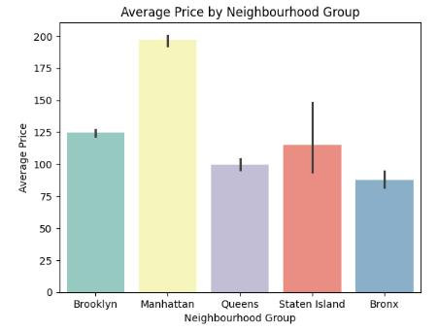
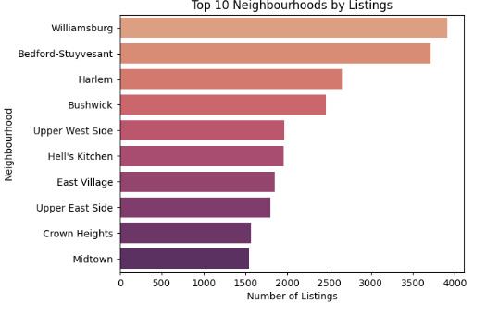
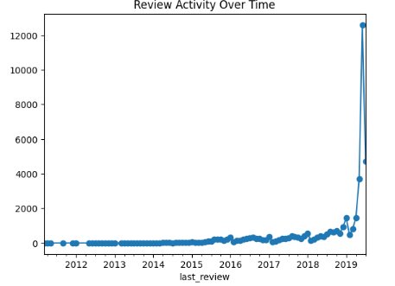
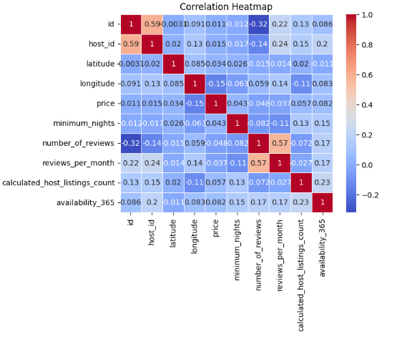
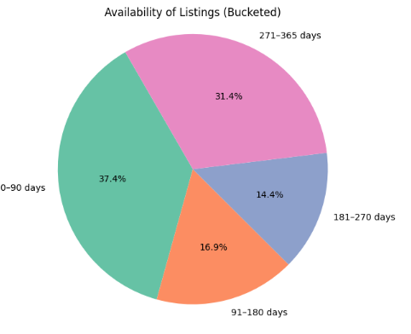
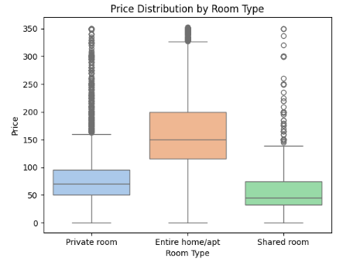
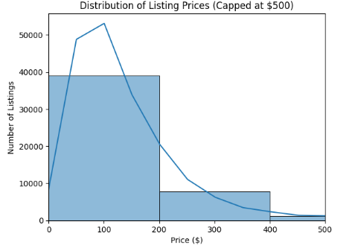
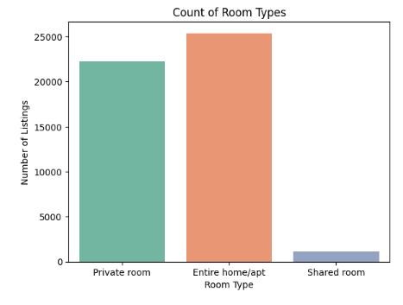
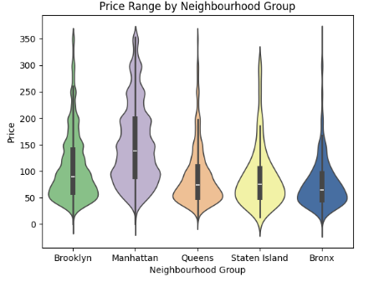

Slide 9
Conclusion
This project gave insights into NYC Airbnb listings and market trends. The data was thoroughly cleaned, visualized, and interpreted to help stakeholders make informed decisions. The analysis can be extended to prediction models and interactive dashboards.

Slide 10
Thank You!
Feel free to explore the dataset and insights on GitHub.
Happy Analyzing! ✨

